Slide 1
HTML Media elements

Slide 2
What is New in HTML5?
The DOCTYPE declaration for HTML5 is very simple:
<!DOCTYPE html>
The character encoding (charset) declaration is also very simple:
<meta charset="UTF-8">

Slide 3
What is New in HTML5?
HTML5 Example:
<!DOCTYPE html>
<html>
<head>
<meta charset="UTF-8">
<title>Title of the document</title>
</head>
<body>
Content of the document......
</body>
</html>

Slide 4
Browser Support
HTML5 semantic elements are supported in all modern browsers.
In addition, you can "teach" older browsers how to handle "unknown elements".

Slide 5
New HTML5 Elements
The most interesting new elements are:
New semantic elements like
<header>, <footer>, <article>, and <section>
New form controls like
number, date, time, calendar, and range
New graphic elements
<svg> and <canvas>
New multimedia elements
<audio> and <video>

Slide 6
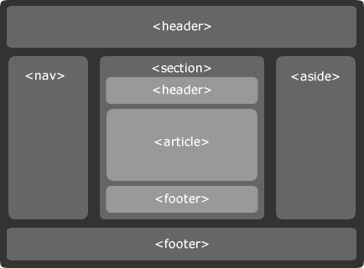
HTML5: What's New

Slide 7
New HTML5 API's (Application Programming Interfaces)
The most interesting new API's are:
HTML Geolocation
HTML Drag and Drop
HTML Local Storage
HTML Application Cache
HTML Web Workers
HTML SSE

Slide 8
HTML5: Video
<video width="320" height="240" controls autoplay>
<source src="movie.ogg" type="video/ogg" />
<source src="movie.mp4" type="video/mp4" />
<source src="movie.webm" type="video/webm" />
Your browser does not support the video tag.
</video>

Slide 9
HTML5: Audio
<audio controls="controls">
<source src="song.ogg" type="audio/ogg" />
<source src="song.mp3" type="audio/mpeg" />
Your browser does not support the audio element.
</audio>

Slide 10
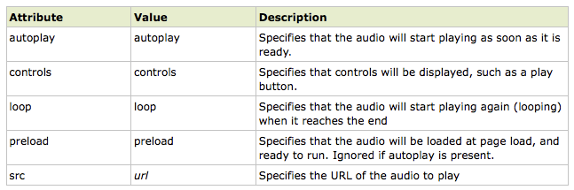
HTML5: Audio

Slide 11
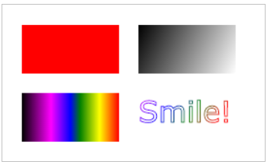
HTML5 Graphics
Tag Description
<canvas> Defines graphic drawing using JavaScript
<svg> Defines graphic drawing using SVG

Slide 12
HTML5: Canvas
The HTML5 canvas element uses JavaScript to draw graphics on a web page.
A canvas is a rectangular area, and you control every pixel of it.
The canvas element has several methods for drawing paths, boxes, circles, characters, and adding images.

Slide 13
HTML5: Canvas
Adding a canvas element to the HTML5 page.
Specify the id, width, height of the element:
<canvas id="myCanvas" width="200" height="100"></canvas>

Slide 14

Add Border
To add a border, use the style attribute.
<canvas id="myCanvas" width="200" height="100"
style="border:1px solid #000000;"> </canvas>

Slide 15
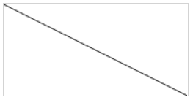
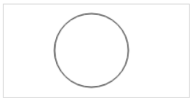
Draw a line
var c = document.getElementById("myCanvas"); var ctx = c.getContext("2d"); ctx.moveTo(0,0); ctx.lineTo(200,100); ctx.stroke();
Draw a Circle
var c = document.getElementById("myCanvas"); var ctx = c.getContext("2d"); ctx.beginPath(); ctx.arc(95,50,40,0,2*Math.PI); ctx.stroke();

Slide 16
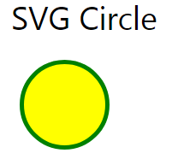
SVG
Scalable Vector Graphics
<!DOCTYPE html> <html> <body> <svg width="100" height="100"> <circle cx="50" cy="50" r="40" stroke="green" stroke-width="4"fill="yellow" /> </svg> </body> </html>

Slide 17
Google Map
<!DOCTYPE html>
<html>
<body>
<h1>My First Google Map</h1>
<div id="map" style="width:400px;height:400px;"></div>
<script>
function myMap() {
var mapOptions = {
center: new google.maps.LatLng(51.5, -0.12),
zoom: 10,
mapTypeId: google.maps.MapTypeId.HYBRID
}
var map = new google.maps.Map(document.getElementById("map"), mapOptions);
}
</script>
</body>
</html>

Slide 18
HTML5: Input types
HTML5 has several new input types for forms.
> email
> url
> number
> range
> date pickers (date, month, week, time, datetime, datetime-local)‏
> search
> color

Slide 19
HTML5: Input - e-mail
The email type is used for input fields that should contain an e-mail address.
The value of the email field is automatically validated when the form is submitted.
E-mail: <input type="email" name="user_email" />

Slide 20
HTML5: Input - url
The url type is used for input fields that should contain a URL address.
The value of the url field is automatically validated when the form is submitted.
Homepage: <input type="url" name="user_url" />
Tip: Safari on the iPhone recognizes the url input type, and changes the on-screen keyboard to match it (adds .com option).

Slide 21
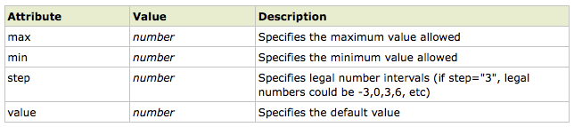
HTML5: Input - number
The number type is used for input fields that should contain a numeric value.
Set restrictions on what numbers are accepted:
Points: <input type="number" name="points" min="1" max="10" />

Slide 22
HTML5: Input - range
The range type is used for input fields that should contain a value from a range of numbers.
The range type is displayed as a slider bar.
You can also set restrictions on what numbers are accepted:
<input type="range" name="points" min="1" max="10" />

Slide 23
HTML5: Input – date pickers
HTML5 has several new input types for selecting date and time:
> date - Selects date, month and year
> month - Selects month and year
> week - Selects week and year
> time - Selects time (hour and minute)‏
> datetime - Selects time, date, month and year
> datetime-local - Selects time, date, month and year (local time)‏

Slide 24
HTML5: Input - search
The search type is used for search fields like a site search or Google search.
The search field behaves like a regular text field.

Slide 25
HTML5: Input – color picker
The color type is used for input fields that should contain a color.
This input type will allow you to select a color from a color picker:
Color: <input type="color" name="user_color" />

